Slide 1


Built in Functions in Python
By Sawyer Mason

Slide 2
What is a Built-in function
A built-in function in Python is a pre-defined process that is always available
No need to import
No need to define

Slide 3
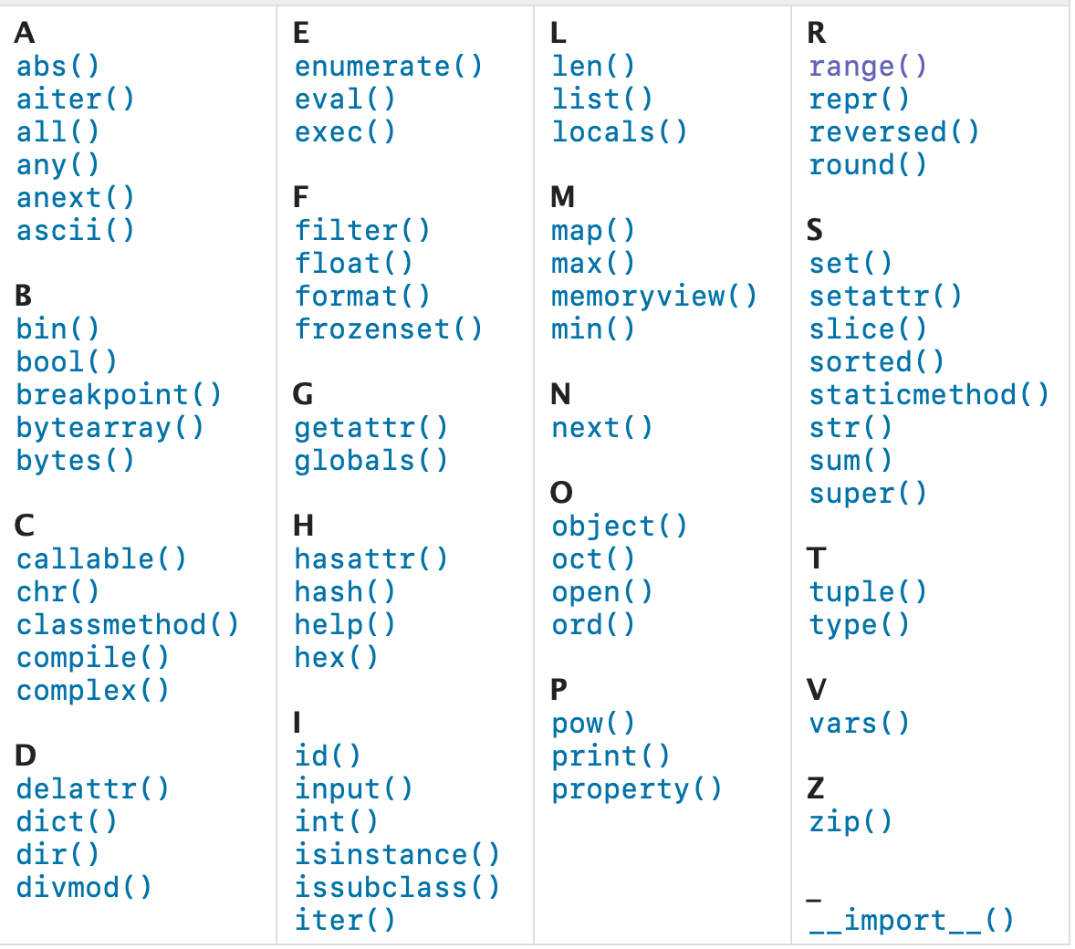
Full list

Slide 4
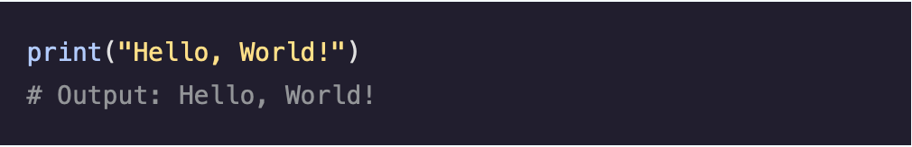
print()
Takes the argument and places it as a str into the output stream

Slide 5
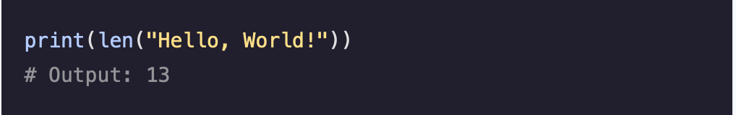
len()
Returns the length of an object

Slide 6
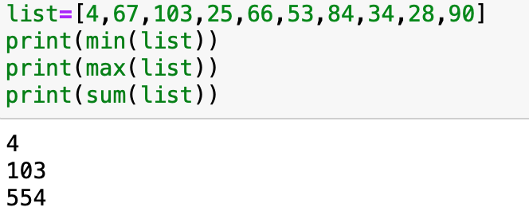
min() max() sum()
Returns the minimum, maximum, or sum of a given interable

Slide 7

Int() float() str()
Takes a given value and returns it in the data type defined by the function

Slide 8
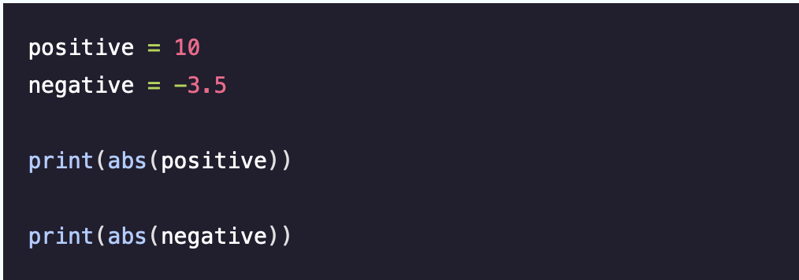


Abs() pow()
Returns the absolute value of an int or a floating-point number

Slide 9
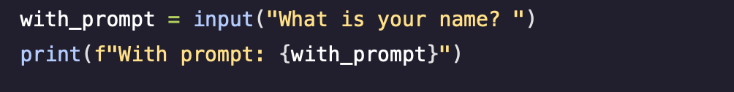
Input()
Allows for the user to input a value that can then be used by any additional functions or processes

